Slide 1

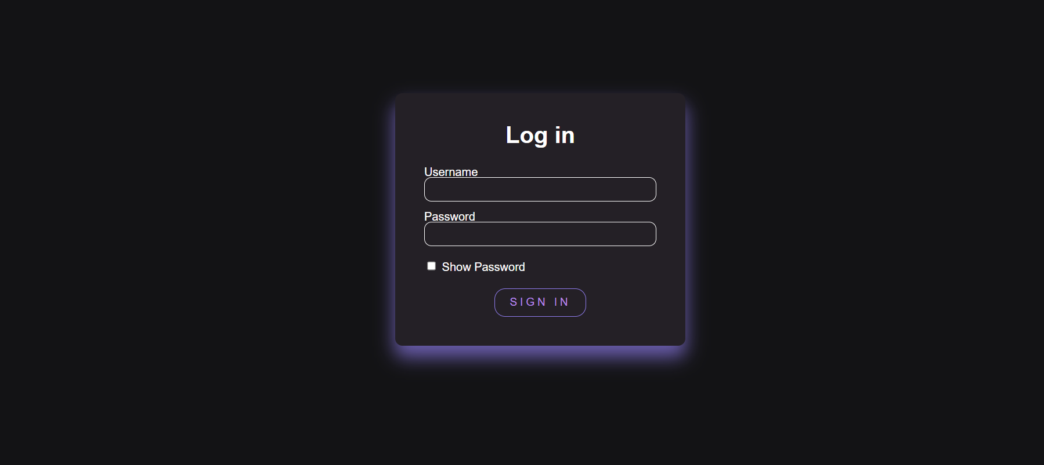
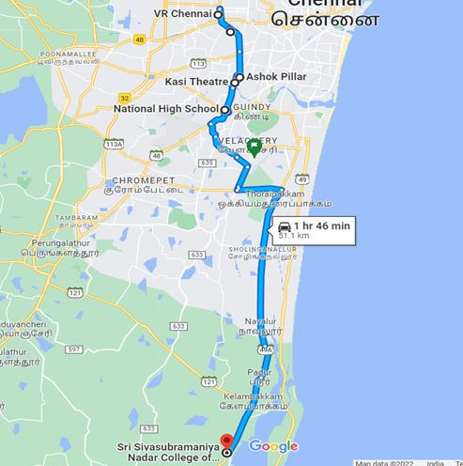
BUS TRACKING SYSTEM USING GOOGLE CLOUD API
TEAM MEMBERS: A.S.Deepesh kumar ,Adhyuth K, Harshath U,Krithiga R
Mentor: Dhivya S
Problem Statement
Working
Login page
This research is based on Bus Tracking System .The main objective of this work is to make a GPS tracking application which would be able to track the college buses .
First we have to login to the website using your username and password. If the entered credentials matches with the database ,then it will navigate you to the map API interface which will show your current location along with bus location and the stop’s location.
Bus Route 10
Solution
Knowledge required
This bus tracking system provides your live location, latitude and longitude of the bus stops .Each and every student has a unique password.
1. HTML and CSS
2. SqLite
3. Flask
4. Google Cloud Services
5. Google Maps API

